Slide 1

Leveraging Deep Learning Models for Sentiment Analysis
Week 12 Mini Survey Luis Alberto Portilla López

Slide 2
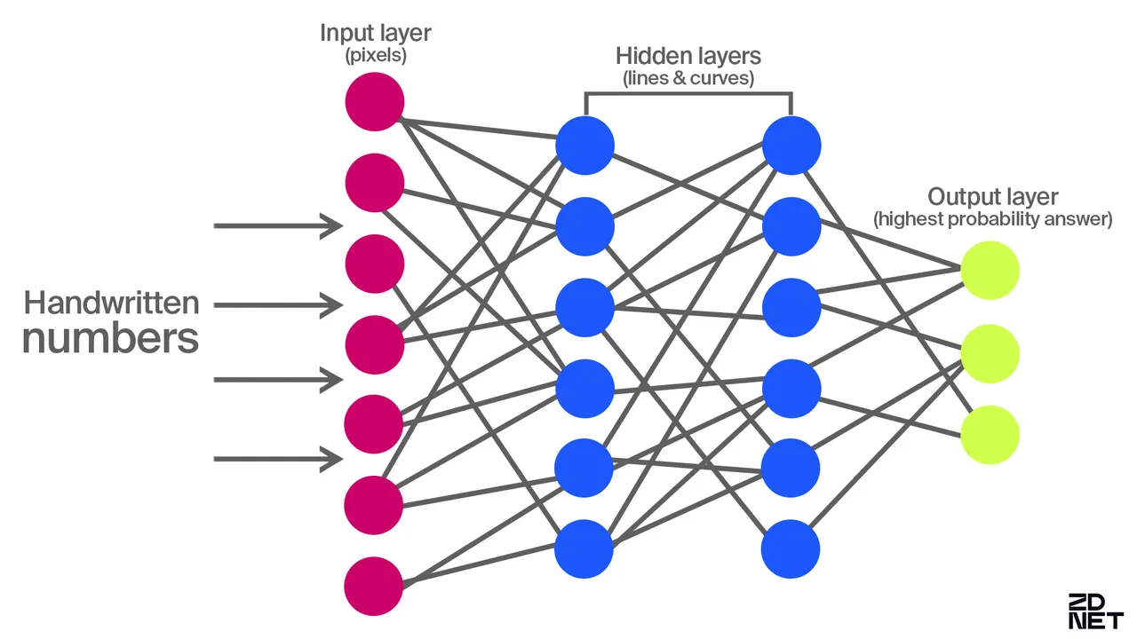
Deep Learning
Deep learning is a subset of machine learning that uses neural networks with many layers (deep neural networks) to model and learn complex patterns from large amounts of data.

Slide 3

Search Methodology & Criteria
Keyword Search
Boolean Search
Citation Chaining and Forward Citation
CRITERIA:
• Initial review of abstracts to assess relevance based on the title, publication venue, and year.
• Direct and indirect relevance to the paper being cross-referenced through the abstract.
• Consideration of the number of citations and field-weighted citation impact (fwci), a metric that measures the citation impact of a paper adjusted for disciplinary differences.

Slide 4

Preliminary Terms
Key terms identified during the week:
Deep neural network
• Sentiment Analysis

Slide 5


Document Comparison
“Deep Learning for Sentiment Analysis: Successful Approaches and Future Challenges”
“Performance Evaluation and Comparison Using Deep Learning Techniques in Sentiment Analysis”
“Meta Transfer Learning for Emotion Recognition”
“Sentiment Analysis for Social Media Data Using Deep Learning Techniques: Review and Approaches”

Slide 6
Characteristic | Deep Learning for Sentiment Analysis: Successful Approaches and Future Challenges | Performance Evaluation and Comparison Using Deep Learning Techniques in Sentiment Analysis | Sentiment Analysis Based on Deep Learning: A Comparative Study | Sentiment Analysis for Social Media Data Using Deep Learning Techniques: Review and Approaches
Primary Focus | Exploration of successful deep learning techniques and challenges in sentiment analysis. | Comparative performance evaluation of deep learning models for sentiment analysis. | Evaluation of deep learning models for sentiment polarity and aspect-based sentiment analysis. | Review of deep learning techniques applied to noisy social media data for sentiment analysis.
Evaluation Metrics | Accuracy, F1-score, Precision, Recall. | Accuracy, F1-score, processing time. | Accuracy, Precision, Recall. | Accuracy, F1-score.
Datasets Used | IMDB, Yelp, Amazon Reviews. | Movie reviews, Twitter datasets. | TripAdvisor, Amazon Reviews. | Twitter, Instagram, Facebook datasets.
Techniques Employed | CNNs, RNNs, and hybrid models. | RNNs, LSTMs, and attention mechanisms. | DNNs, CNNs, RNNs. | LSTMs, CNNs, hybrid approaches.

Slide 7
Characteristic | Deep Learning for Sentiment Analysis: Successful Approaches and Future Challenges | Performance Evaluation and Comparison Using Deep Learning Techniques in Sentiment Analysis | Sentiment Analysis Based on Deep Learning: A Comparative Study
Key Contributions | Overview of state-of-the-art deep learning techniques for sentiment analysis. | Comprehensive comparison of model efficiency and accuracy. | Highlighting the strengths and weaknesses of different deep learning models.
Novelty | Analysis of emerging challenges such as sarcasm and domain adaptation. | Empirical focus on trade-offs between accuracy and computational cost. | Emphasis on aspect-based sentiment and multilingual datasets.

Slide 8
References
• Zhuang, Fuzhen, et al. “A Comprehensive Survey on Transfer Learning.” IEEE Transactions on Knowledge and Data Engineering, vol. 34, no. 1, 2022, pp. 115-157.
• Seyeditabari, Armin, Narges Tabari, and Wlodek Zadrozny. “Emotion Detection in Text: A Review.” arXiv preprint arXiv:1806.00674, 2018.
• Nguyen, Dung, et al. “Meta Transfer Learning for Emotion Recognition.” Neural Computing and Applications, vol. 35, no. 14, 2023, pp. 10535-10549.

